Slide 1
GA SF: Data Science Immersive
Instructors: Vrushank Vora, Alexander Barriga, Varsha Pullabhotla

Slide 2
INTRODUCTIONS
Why are you spending the next 3 months at General Assembly?
Beyond technical skills, how do you want to grow in the next 3 months?
What is one thing that you believe is possible that others believe is impossible?

Slide 3
INTRODUCTIONS
Data Products drive decisions (e.g. Amazon’s Rec Engine), automate complex tasks (self-driving cars), and uncover hidden patterns (Deep Learning for Genomics).
With a group of three people, envision a data product from scratch:
What problem will the data product solve?
Who will use it?
What broader impact will it have on society? What do you envision the intended and unintended consequences to be?.

Slide 4
“Programs are not just algorithms as concepts or applied ideas. They are algorithms in motion. Code is uniquely kinetic. It acts and interacts with itself, with the world. In code, the mental and the material are one. Code moves. It changes the world.” Vikram Chandra, Geek Sublime

Slide 5
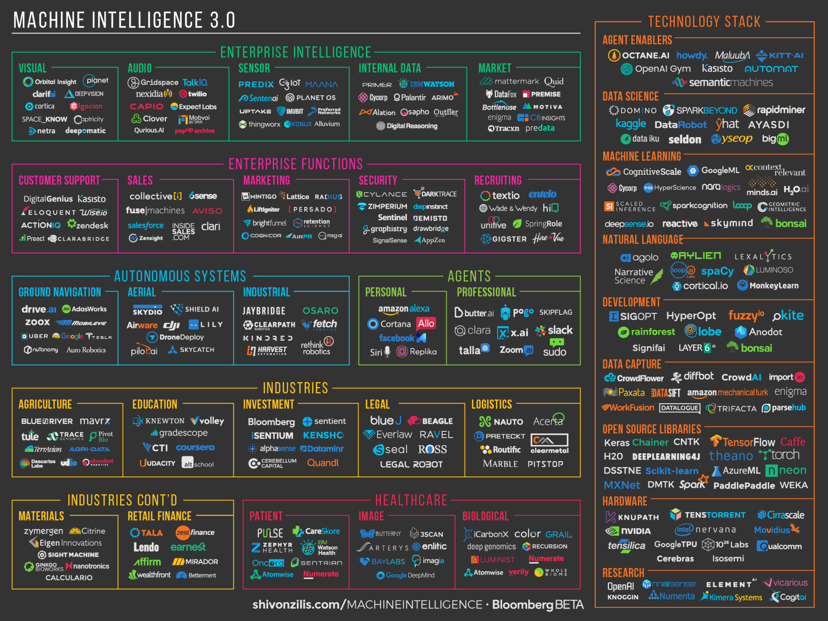

Slide 6
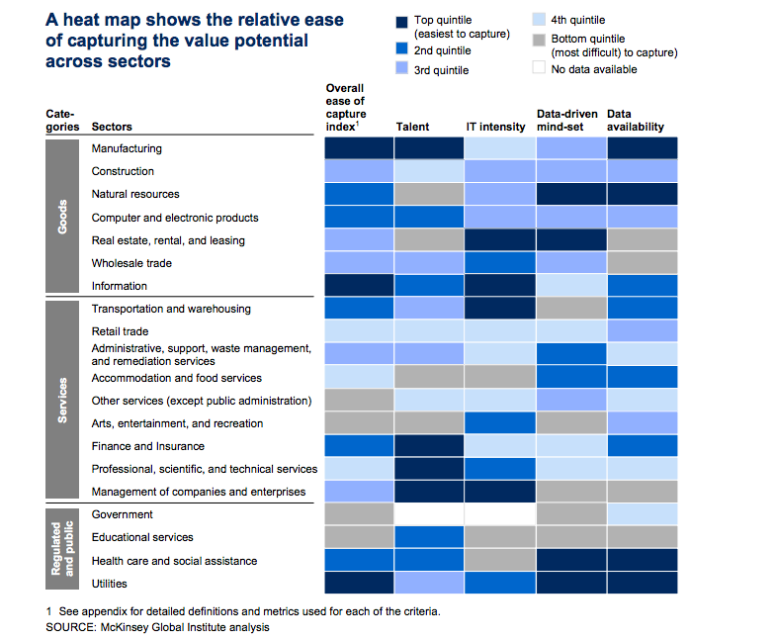

Slide 7
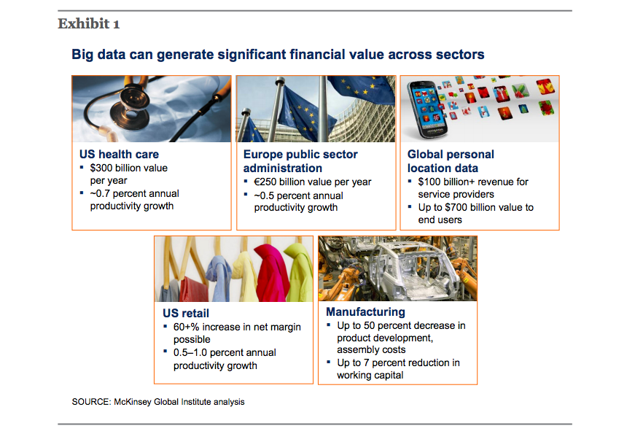

Slide 8
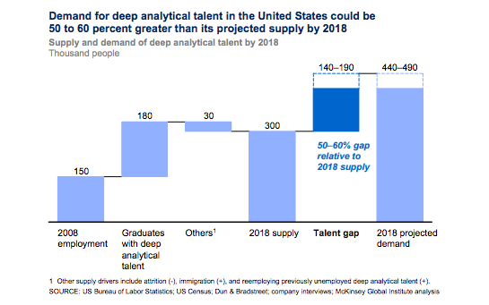

Slide 9
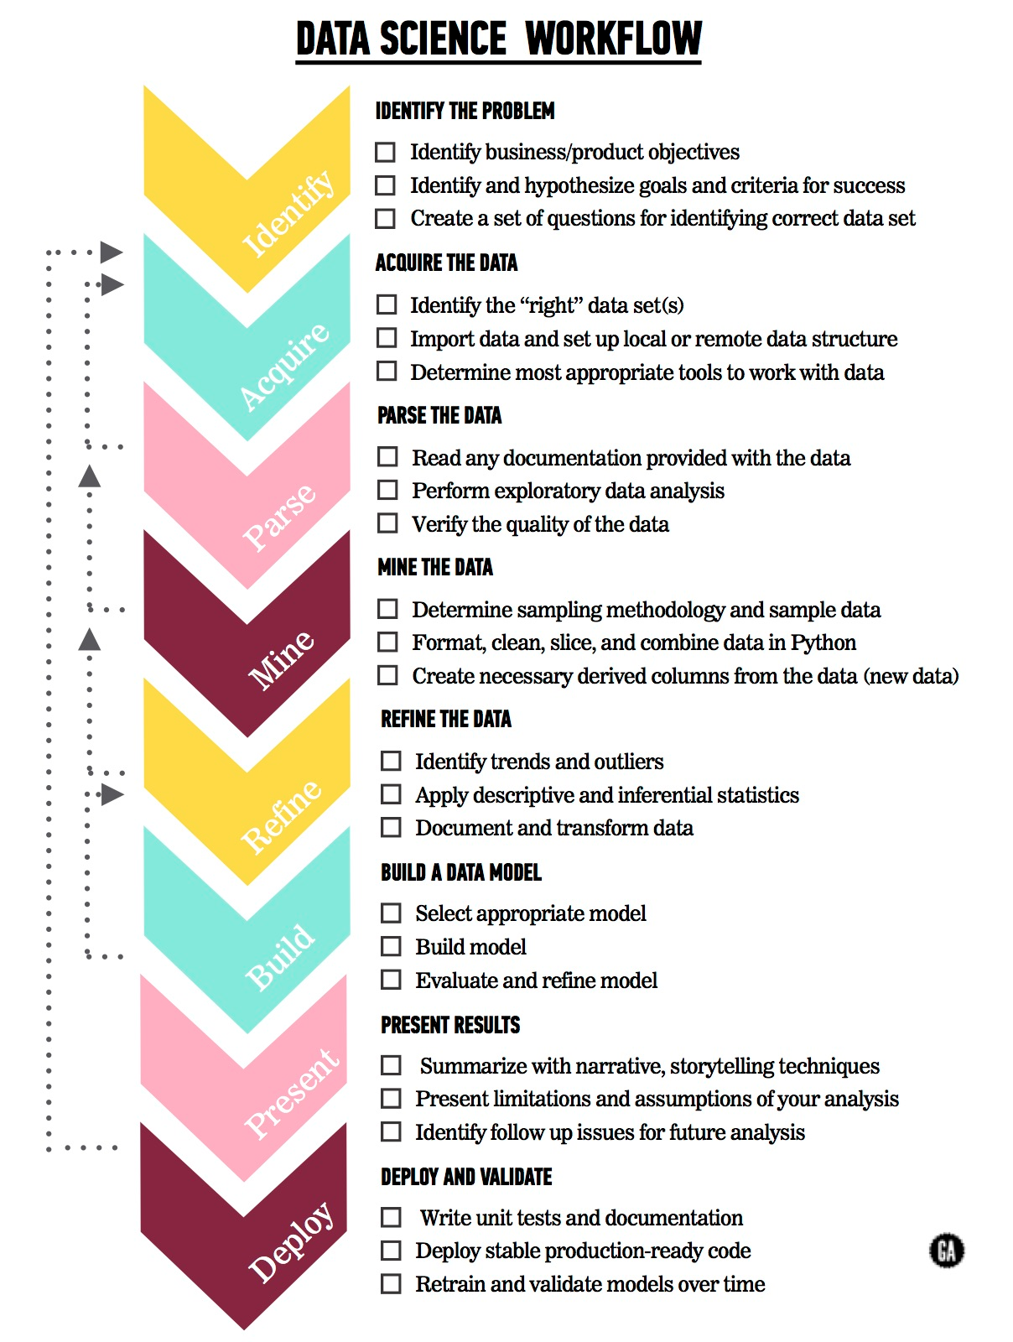
DATA SCIENCE: PROCESS
Notes:
Charlie voiceover

Slide 10
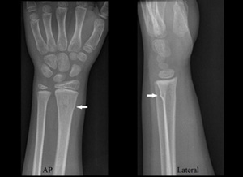
DATA SCIENCE: PROCESS
 | Identify the Problem | Acquiring the Data | Parse the Data | Mine the Data | Refine the Data | Build a Data Model | Present and Evaluate Results | Deploy and Validate Results
Skills | Business Acumen, Product Focus | Relationship building, Software Engineering | Software Engineering | Statistics, SWE | Statistics, Machine Learning | Machine Learning | Statistics, Common Sense | SWE
Example | Radiologists are not keeping up with the pace at which medical images are being created. | Create partnerships with hospitals. Still need to take data out from old school infrastructure. | Make sure the quality of the X-ray images is high. | Sample a small portion of 100mil images to prototype algorithms. | Make sure sample of X-ray images is representative of the broader population. | Build a CNN to diagnose fractures. | Models achieve super human level accuracy. | Deploy model to the cloud to predict on future data.

Slide 11
DATA SCIENCE IMMERSIVE
1 | Engineering and Python Foundations | Data Acquisition, Data Engineering
2 | Linear Algebra, Statistics | Evaluate Results
3-6 | Machine Learning, Natural Language Processing | Build Models, Evaluate Results
7 | Web Scraping, APIs, Flask | Data Acquisition, Deployment
8 | Big Data (Spark, Hadoop), Databases | Data Storage, Data Deployment
9 | Recommender Systems, A/B Testing and Multi-Armed Bandits | Model Evaluation and Validation, End to End Data Products
10-12 | Deep Learning, Capstone | End to End Data Products

Slide 12
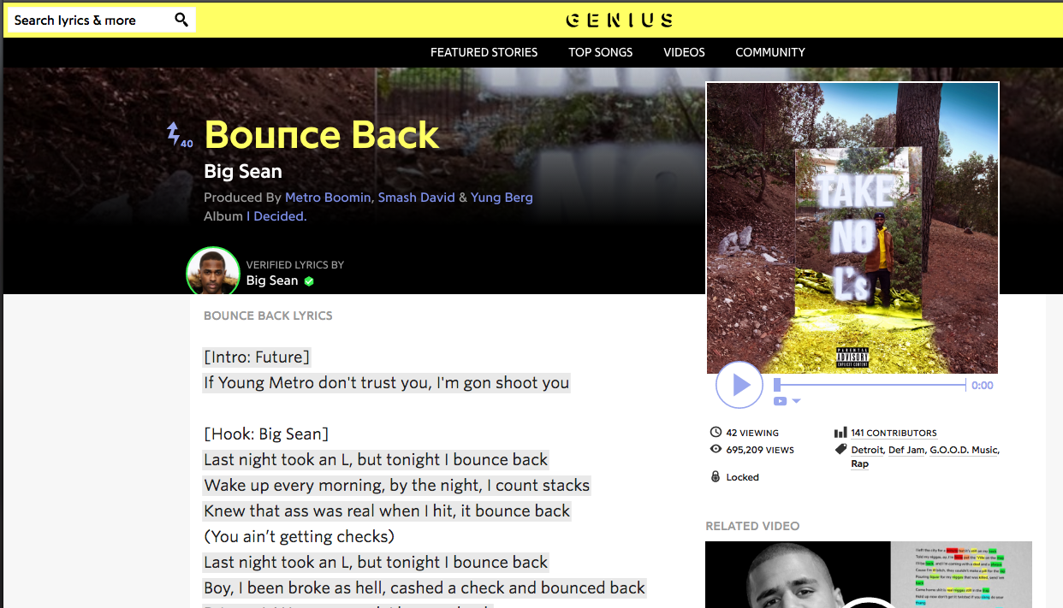
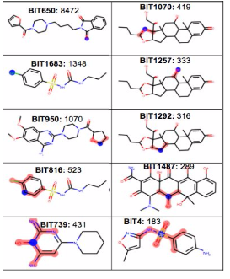
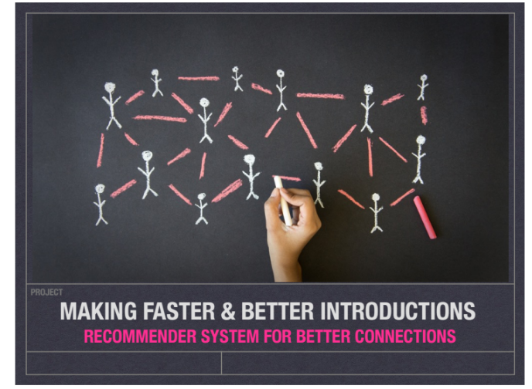
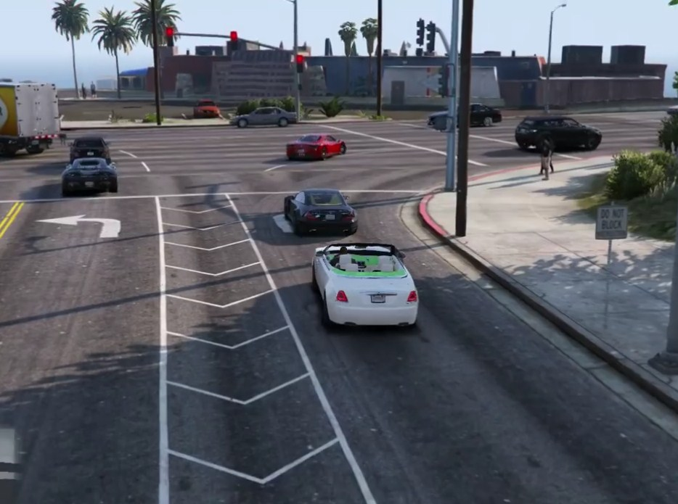
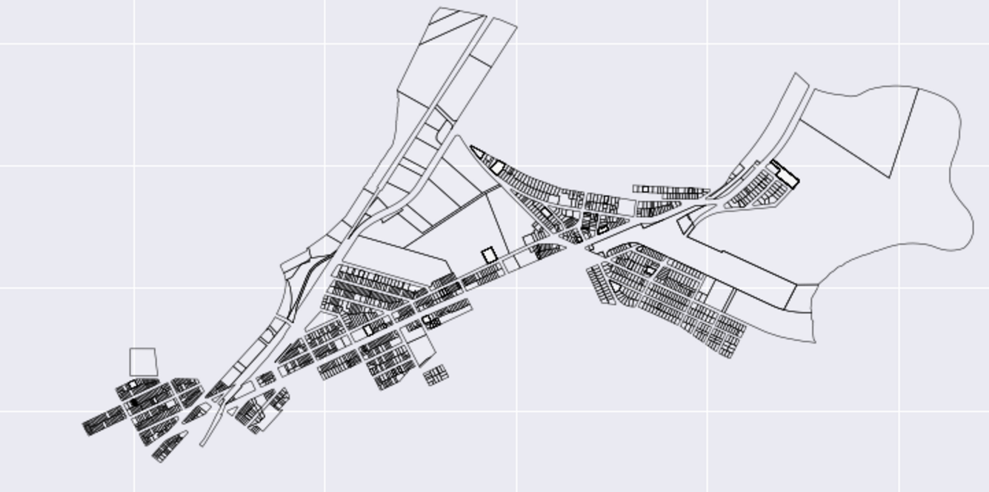
DATA SCIENCE IMMERSIVE: CAPSTONES

Slide 13
Questions?

